Slide 1
CS 498
Virtual Reality
Design Processes
(For internal use only)
Set 3

Slide 2
VR Design: General Concerns
Platforms
Numbers (end of 2018)
Samsung Gear: 7.8M
PSVR: 4M
Oculus Go: 1M
HTC Vive and Rift are under 1M each (hard to find numbers)
The platform you develop for has impact on the product
Sales usually means going for the broadest market which can impact key elements
User interface
Scope (memory limitations as well as user comfort)
Graphics
Content volume (cost related)

Slide 3
VR Design: General Concerns
Immersion vs. Presence (Michael Abrash)
Immersion is being presented with data from a false environment
Your brain/body know it is false but you suspend disbelief
Examples include Books, cinema, TV, etc.
Presence is having your body believe in the new environment on a fundamental level
The subconscious perceptual systems believe in the illusion
Hearing, proprioception, touch, etc.

Slide 4

VR Design: General Concerns
Issues with Presence
Cognitive load
Cognitive load refers to the amount of mental processing power needed to use your product.
Think of the things that a new user faces when they first enter VR
Confusion
Lack of Direction
Lack of know how

Slide 5
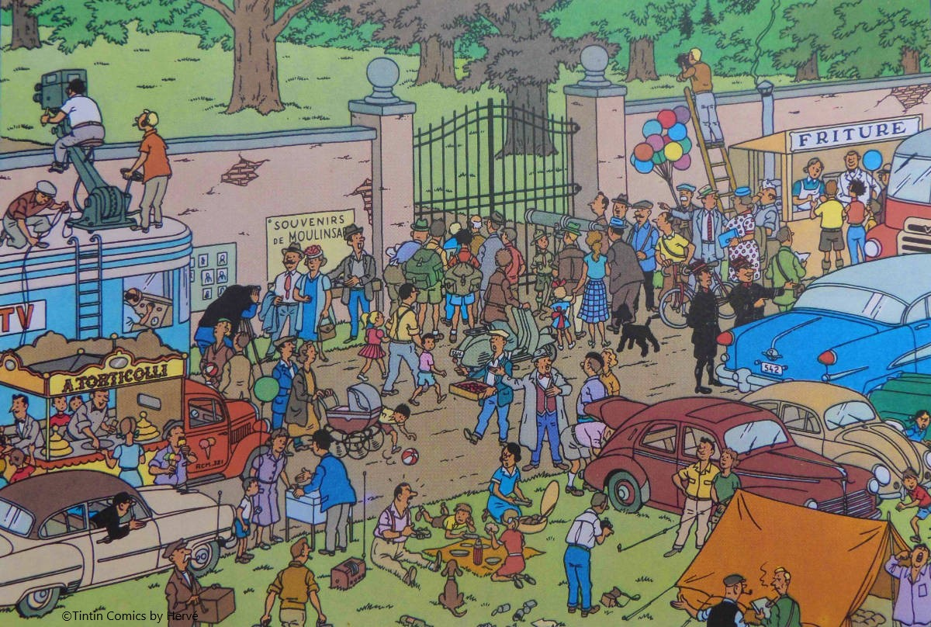
VR Design: Dealing with Cognitive Load
Cognitive load study
Simplify the scene (at least at first)
Give users control of their navigation
Driver vs. Passenger
Give the user clear directions/goals
Progress reports/hints
Avoid Depth Confusion
UI can be problematic here
Use Rest Frames if possible
Fidelity should match the Target system
Head turning on mobile
Notes:
Cognitive overload, This is from Tin tin an old comic and the density of the comic was meant to cause the reader to pause.

Slide 6
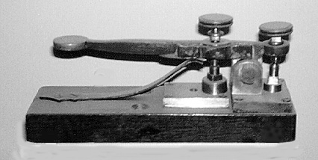
VR Design: General Concerns
Issues with Presence (cont)
Kinematic load (repetitive overload)
Kinematic load refers to the amount of physical activity needed to use your product.
Google Study on how people enjoy VR

Slide 7
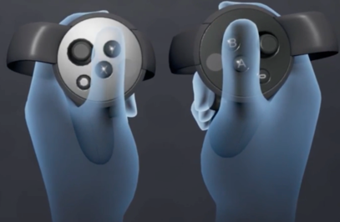
VR Design: Dealing with Kinematic Load
Limit arm, elbow and hand movement
We will speak specifics in a bit
Build simply and support high end
Oculus best practices

Slide 8

VR Design: General Concerns
Issues of Control
Users must feel they control their space
This is very important when you have walk around room sizes
Direction is paramount
Knowing what to do and how to do it gives the feeling of control
Managing choices can be an issue with less input methodologies
Error handling in interactions can be problematic
Leads to frustration and the feeling of loss of control

Slide 9
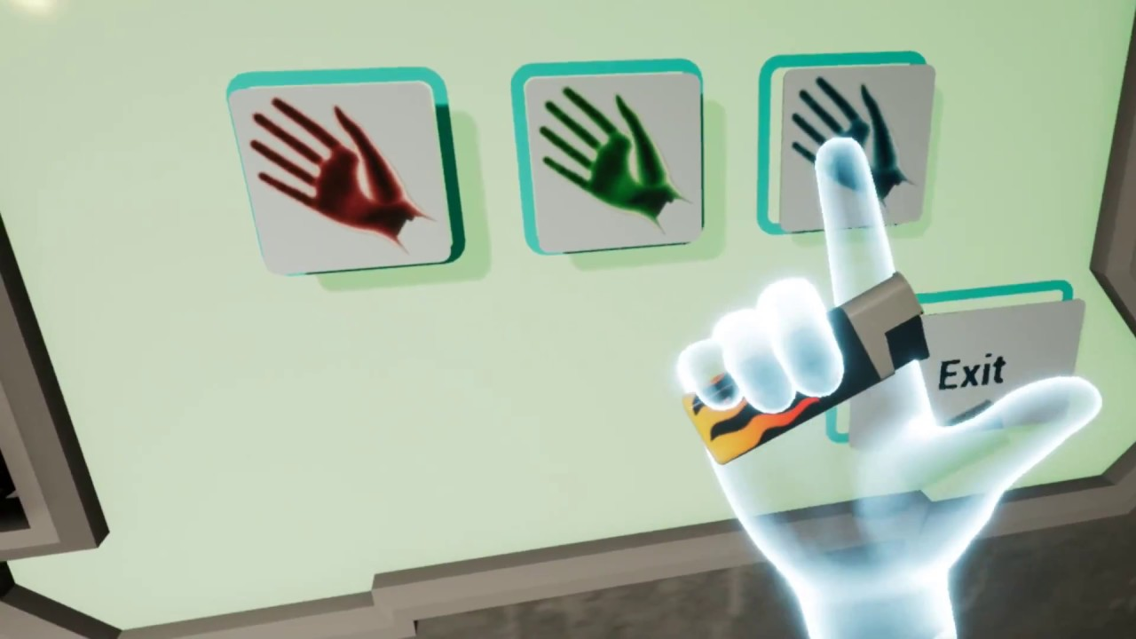
VR Design: Summary of General Concerns Yasser Malaika (Valve), Patrick O'Luanaigh (nDreams) Mike Agler (Google) , Design Best Practices (Oculus)
Presence but not full reality
Keep the user in your world but simplify the repetitive and mundane
Hand representation is key, players notice when things are wrong with game hands
Non-realistic hands
Don’t create an expectations where hands have to do more than is comfortable in VR

Slide 10
VR Design: Summary of General Concerns Yasser Malaika (Valve), Patrick O'Luanaigh (nDreams) Mike Agler (Google) , Design Best Practices (Oculus)
Don’t create objects that don’t behave as expected (handles on pots, etc.)
Make sure that objects with interactable elements are interactable
Drawers with handles should open, etc.
Real isn’t as important as ease of use an simple functionality
Watch out for simulation fatigue
Don’t make a person use big gestures to do common place things
Make any gesture a satisfying and meaningful experience

Slide 11
CS 498 VR Design Elements
Design Phase (Discovery) is coming up
Starts with Team creation
Survey has got out and we are putting together the teams right now
Discovery is the phase used to design or clarify the vision and high level design

Slide 12
Main Project Production Begins
Discovery (already done) |  | Discovery (2 week Milestone) |  | Pre Production (2 Week Milestone)
 |  |  |  |  |  | Production (9 Weeks)
 |  |  |  |  |  |  |  |  |  |  |  |  |  |  |  |  |  |  |  |  |  | Street
Proof Of Concept
Discovery: Milestone Due TBD (around 10/4/2019)
Pre-Production: Milestone Due TBD (around 10/18/2019)
Production
Beta Final
Alpha
Due 11/29/2019
Discovery:
High Vision Canvas: Use the template provided and the example to create a clear vision for your group project.
High Level Action Loop: Prepare an action loop that shows the main flow of your app/game.
Feature List: Use the Canvas and Action Loop to set the main features of your app/game. Use the Feature List template.
Team Milestone Plan: Create a simple team milestone for the 2-week pre-pro phase using the milestone template.
TAs will be set for the Projects on Thursday and they will help guide you through the Discovery Process

Slide 13

Vision Canvas – Single Project/Level Version
Process for Completion:
Come up with an IDEA
Or
Get a strong understanding of what your project originator’s idea is.

Slide 14
Vision Canvas
The layout is important
App/Game Name
Descriptive
Genre
World
Inspirations
Targets
User Experience
User Types
Foundational
Core Pillars
Core Systems
High Level Vision Canvas
App/Game Name
Inspirations (note what it is inspiring) | Genre (ex: RPG, Travel) | Core Pillars (in the form "Player can...") | Core Systems (ex: Save/Load or Combat) | User Experience (the emotion elicited)
 | IP/World (ex: Sci-fi, Beach)
 |  |  |  | Player Types (rank by priority)

Slide 15
 |  |  | High Level Vision Canvas
Project Name
Inspirations (note what is it inspiring) | Genre (ex: 3rd Person) | Genre (ex: 3rd Person) | Core Pillars (in the form "User can...") | Core Systems (ex: Save/Load or Combat) | User Experience (the emotion elicited)
Inspirations inform about what the usage, gameplay, tone (humor or atmosphere), UI, Audio, and art style are like by providing similar examples | The Genre describes, informs, and constrains the usage and camera style and sets expectations for the team what the team will be building for the User. These should be common genres | The Genre describes, informs, and constrains the usage and camera style and sets expectations for the team what the team will be building for the User. These should be common genres | The core pillars are the actions the user can perform that define the user actions (the core mechanics) that, if removed would change the user experience. | Core Systems are the key programmatic features/systems that need to be created to build your project, they should directly relate to Core Pillars and should also contain those systems needed that are not core but necessary (for example Save/Load) | The User experiences should be the foundation for your core mechanics (Core Pillars and Core Systems). They should be the emotional experiences you are trying to evoke from the user.
Inspirations are key, they show others what surrounds your idea and makes it special. | Don't put world descriptors here, (Zombies are not a Genre, they are an element of the world, the genre would be Survival) | Don't put world desciptors here (Zomibes are not a Genre, they are an element of the world, the genre is survival) | Make sure each core pillar reflects/supports a user experience. | Don't forget those background elements that drive key game play mechanics (AI, Audio, UI, etc.) These are key systems. | If you want to build something that has an impression on users, then you need to develop this element properly, with real consideration for experiences you have had as well as emotions you want to drive.
Remember to note what part of the game each element inspires. |  |  | Grouping like elements or sub elements is good for clarity (ex: pillars about ranged and melee combat would fit under a more general combat pillar) | The details in this and core pillars drive the feature list. Be thoughtful here, start with higher level elements and then add contributing background elements). | If you don't have much to offer here you may need to consider adding depth to what you are building (if a tour say, you might want to gamify it in some way).
 | IP/World (high level descriptions) | IP/World (high level descriptions) | Don’t put emotions here, they belong in User Experiences. They can be rewritten as core pillars. |  | User Types (prioritized)
 | The IP/World element is there to provide context for where the game/project is being placed. Elements about Narrative and environment belong here. | The IP/World element is there to provide context for where the game/project is being placed. |  |  | These are the types of users you think your project will attract. These should be prioritized by size of group (biggest first). This list helps you make decisions when conflicts arise between supporting features and handling scope.
 | This is more important that most designers realize. Adding enough detail to describe the context of what you are building in just a few lines of text is key. | Elements about Narrative and environment belong here. |  |  | We found that personalizing the Names for these groups helped describe them. Knowing these groups well helps define your efforts.
 | Timeframes matter (For example: Sci fi Technology can vary greatly based on how far in the future we are talking about. | This is more important that most designers realize. Adding enough detail to describe the context of what you are building in just a few lines of text is very important. |  |  | You don’t have to be one of these types, but you need to find these types to try your app to make sure it is meeting their needs.

Slide 16
Vision Canvas – Single Project/Level Version
Determine the Descriptors
Define the Genre
1st Person or 3rd, Travelogue, Shooter
Don’t include info about the world
Expectation is for standard Genre vernacular
Describe the World/Environment or IP
Information about the background of the world
Post Apocalyptic, Sci Fi, Japan, Beach , etc.
Licensed Intellectual Properties, etc.
Concepts
Narrative
These define the physical world, supplying context, interactions and connections. They describe how the user interacts (ex: camera view) and relates (especially for a existing IP).
High Level Vision Canvas
App/Game Name
Inspirations (note what it is inspiring) | Genre (ex: RPG, Travel) | Core Pillars (in the form “User can...") | Core Systems (ex: Save/Load, Combat) | User Experience (the emotion elicited)
 | IP/World (ex: Sci-fi, Beach)
 |  |  |  | User Types (rank by priority)

Slide 17
Genre (ex: 3rd Person)
The Genre describes, informs, and constrains the usage and camera style and sets expectations for the team what the team will be building for the User. These should be common genres
Don't put world desciptors here (Zombies are not a Genre, they are an element of the world, the genre would be Survival)
IP/World (high level descriptions)
The IP/World element is there to provide context for where the game/project is being placed. Elements about Narrative and environment belong here.
This is more important that most designers realize. Adding enough detail to describe the context of what you are building in just a few lines of text is key.
Timeframes matter (For example: Sci-fi tech. can vary greatly based on how far in the future we are talking about).

Slide 18
Vision Canvas – Single Project/Level Version
Descriptors, continued:
Write down all your inspirations
Get specific
UI
Game play features
Tone (Tone Targets)
Style (Graphic look)
Lighting
This helps define the emotional elements the user will be experiencing.
High Level Vision Canvas
App/Game Name
Inspirations (note what it is inspiring) | Genre (ex: RPG, Travel) | Core Pillars (in the form “User can...") | Core Systems (ex: Save/Load, Combat) | User Experience (the emotion elicited)
 | IP/World (ex: Sci-fi, Beach)
 |  |  |  | User Types (rank by priority)

Slide 19
Inspirations (note what is it inspiring)
Inspirations inform about what the usage/gameplay, tone (humor or atmosphere), UI, Audio, and art style are like by providing similar examples.
Inspirations are key, they show others what surrounds your idea and makes it special. Remember to note what part of the game each element inspires.

Slide 20
Vision Canvas – Single Project/Level Version
Target Information
User Experience
The emotional experience the user is having
Should relate to core pillars
Player Types
Self defined
Should be descriptive
Should represent the key player/purchasers
In descending order
Don’t go too broad
Make up your own descriptors
High Level Vision Canvas
App/Game Name
Inspirations (note what it is inspiring) | Genre (ex: RPG, Travel) | Core Pillars (in the form “User can...") | Core Systems (ex: Save/Load, Combat) | User Experience (the emotion elicited)
 | IP/World (ex: Sci-fi, Beach)
 |  |  |  | User Types (rank by priority)

Slide 21
User Experience (the emotion elicited)
The User experiences should be the foundation for your core mechanics (Core Pillars and Core Systems). They should be the emotional experiences you are trying to evoke from the user.
If you want to build something that has an impression on users, then you need to develop this element properly, with real consideration for experiences you have had as well as emotions you want to drive.
If you don't have much to offer here you may need to consider adding depth to what you are building (if it’s a tour say, you might want to gamify it in some way).
User Types (prioritized)
These are the types of users you think your project will attract. These should be prioritized by size of group (biggest first). This list helps you make decisions when conflicts arise between supporting features and handling scope.
We found that personalizing the Names for these groups helped describe them. Knowing these groups well helps define your efforts.
You don’t have to be one of these types, but you need to find these types to try your app to make sure it is meeting their needs.

Slide 22
Vision Canvas – Single Project/Level Version
Foundational Elements
Core Pillars
Features that drive the User Experience
In the form: “The User will …..”
Core Gameplay Systems
Systems that support the core pillars and other key aspects of the app/game
Points to key low level systems
Examples: Traversal, UI, AI (if needed).
High Level Vision Canvas
App/Game Name
Inspirations (note what it is inspiring) | Genre (ex: RPG, Travel) | Core Pillars (in the form “User can...") | Core Systems (ex: Save/Load, Combat) | User Experience (the emotion elicited)
 | IP/World (ex: Sci-fi, Beach)
 |  |  |  | User Types (rank by priority)

Slide 23
Core Pillars (in the form "User can...")
The core pillars are the actions the user can perform that define the user actions (the core mechanics) that, if removed would change the user experience.
Make sure each core pillar reflects/supports a user experience.
Grouping like elements or sub elements is good for clarity (ex: pillars about ranged and melee combat would fit under a more general combat pillar)
Don’t put emotions here, they belong in User Experiences. They can be rewritten as core pillars.

Slide 24
Core Systems (ex: Save/Load or Combat)
Core Systems are the key programmatic features/systems that need to be created to build your project, they should directly relate to Core Pillars and should also contain those systems needed that are not core but necessary (for example Save/Load)
Don't forget those background elements that drive key game play mechanics (AI, Audio, UI, etc.) These are key systems.
The details in this and core pillars drive the feature list. Be thoughtful here, start with higher level elements and then add contributing background elements).

Slide 25
Design Docs Process: Simple Action Loop
Win/Lose, no repeat
Lose, repeat
Start
S01
Home Base
S02
Mission
S03
Combat
S04
Death

